Slide 1
EDUCATIONAL INSTITUTION «SUKHOI STATE TECHNICAL UNIVERSITY OF GOMEL»
Compiled by: student gr. IT-23 Nour Alden Mohammad Saad Awawdeh
Practice leader: Kurochka Konstantin Sergeevich.
“WPF applications for accounting sales of drinks and snacks in a coffee shop” "Object-oriented design and programing"

Slide 2


Havana Restaurant

Slide 3

Architecture of the Application

Slide 4
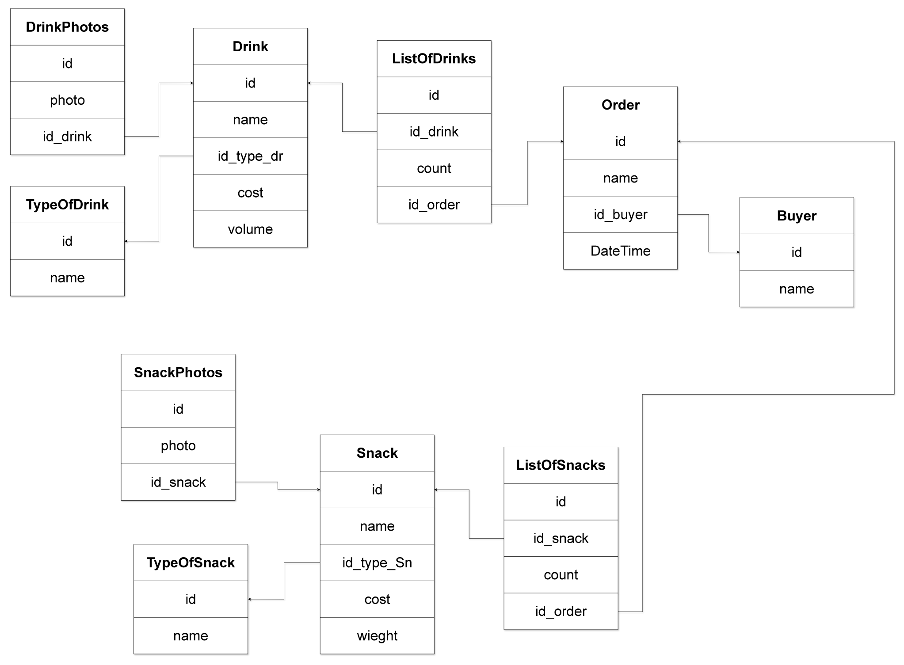
Database Architecture

Slide 5
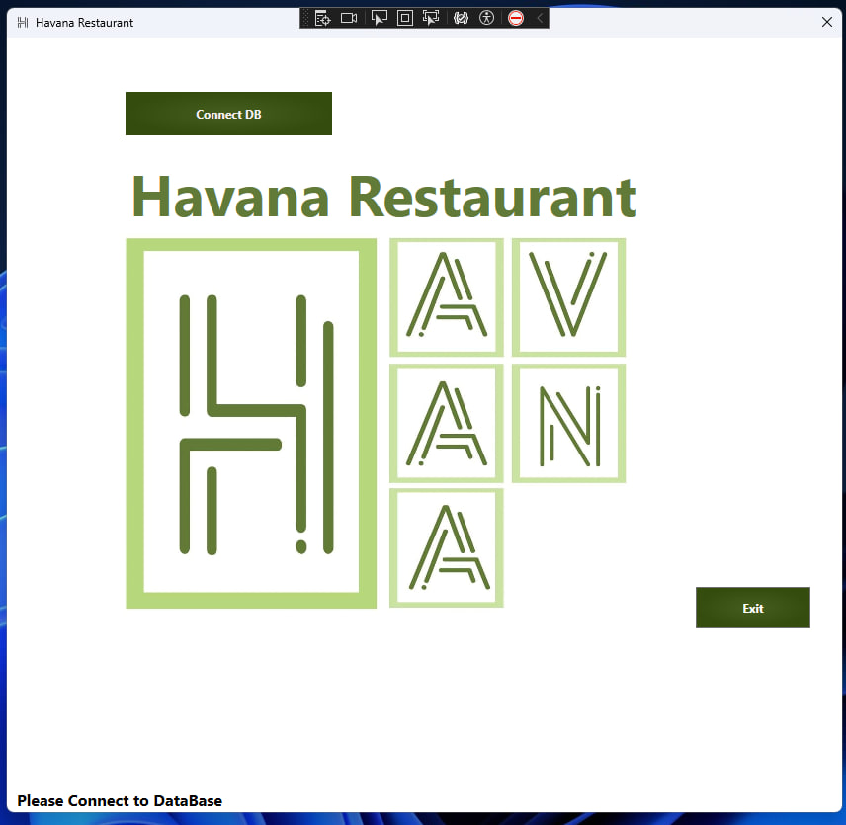
WPF Windows Presentation Foundation

Slide 6
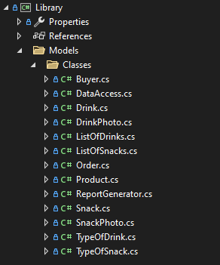
C# OOP Classes

Slide 7
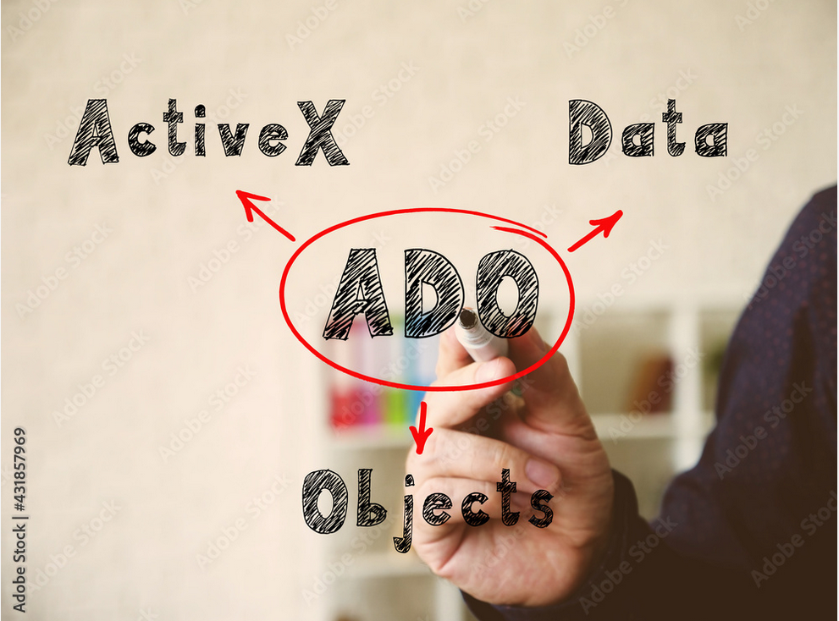
ADO (ActiveX Data Objects) Data access between Rational and non Rational Systems

Slide 8

Order From Us

Slide 9
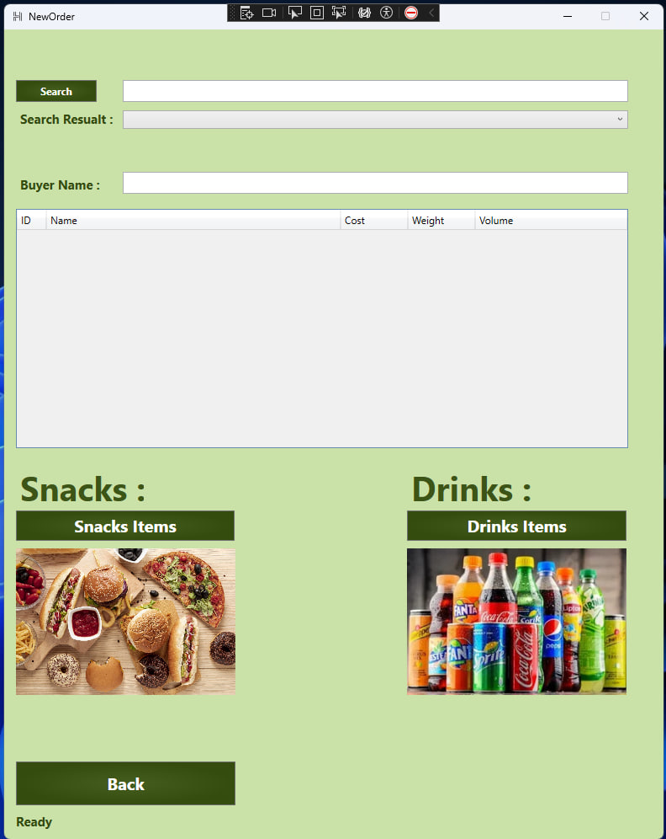
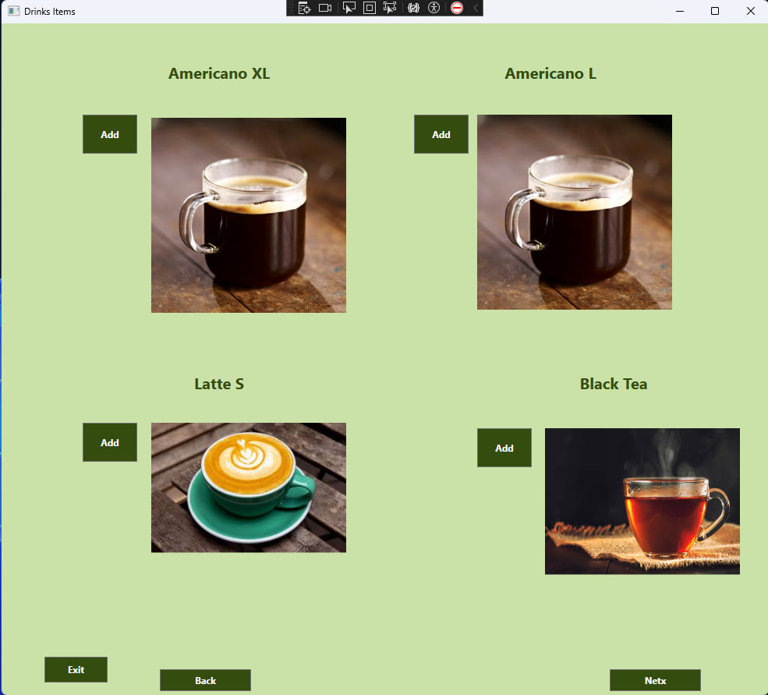
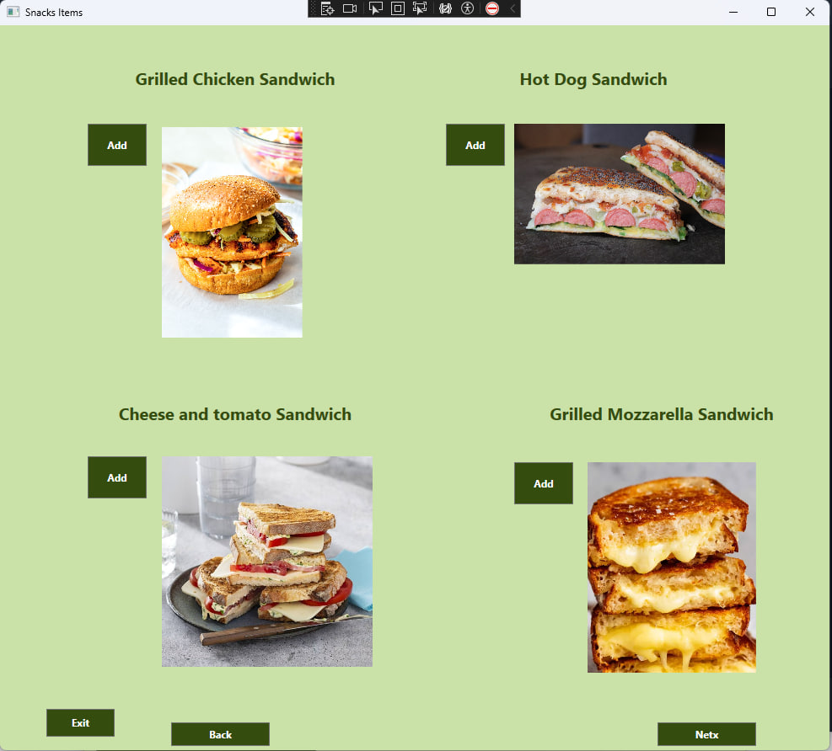
Order

Slide 10
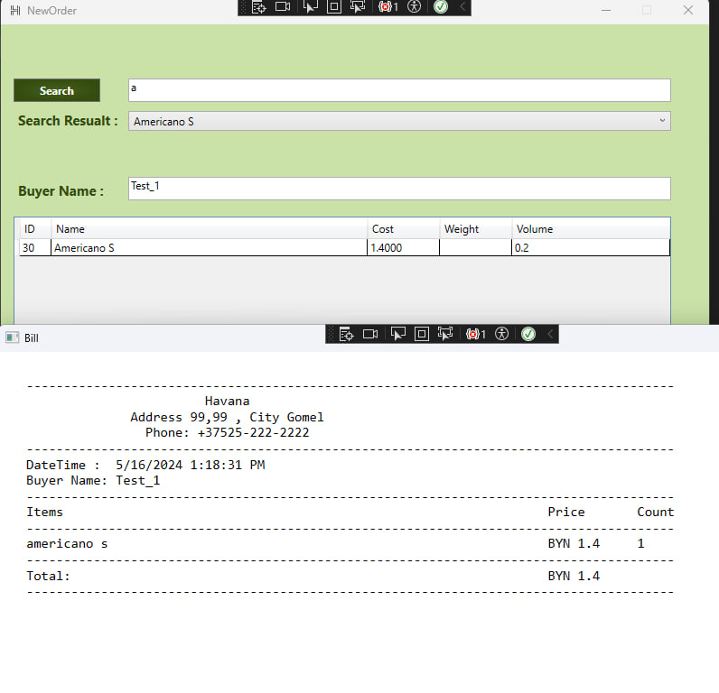
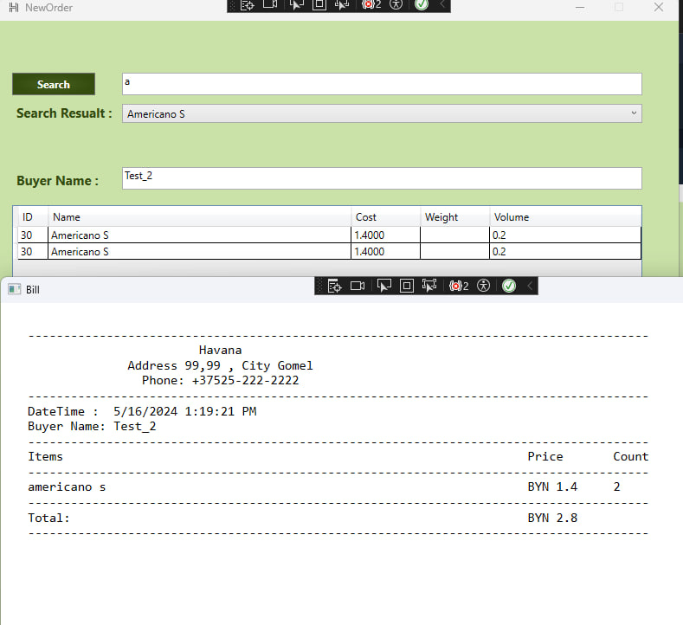
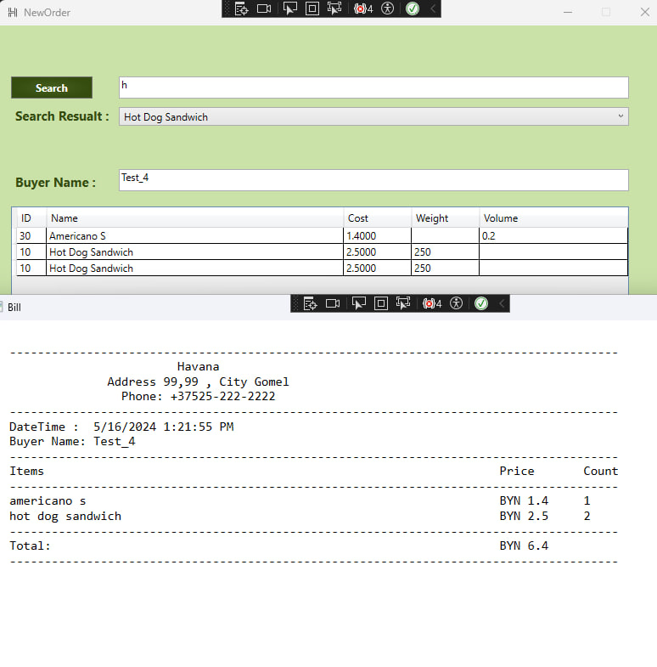
Test my Application

Slide 11
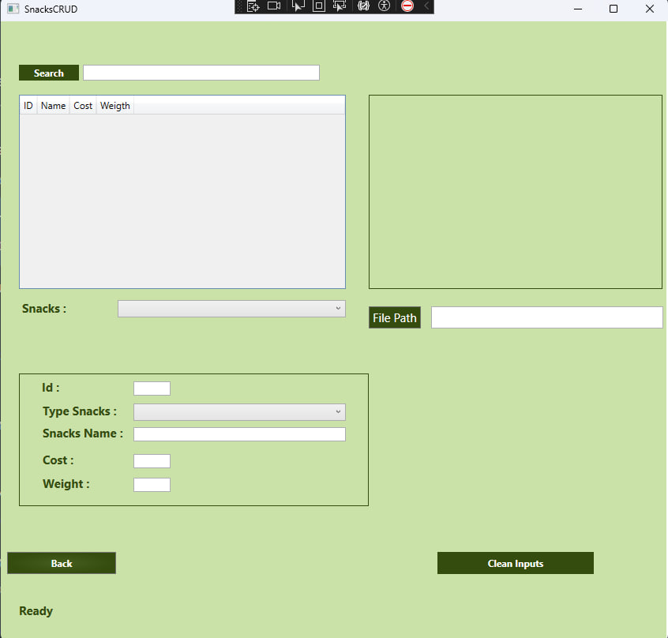
CRUD

Slide 12
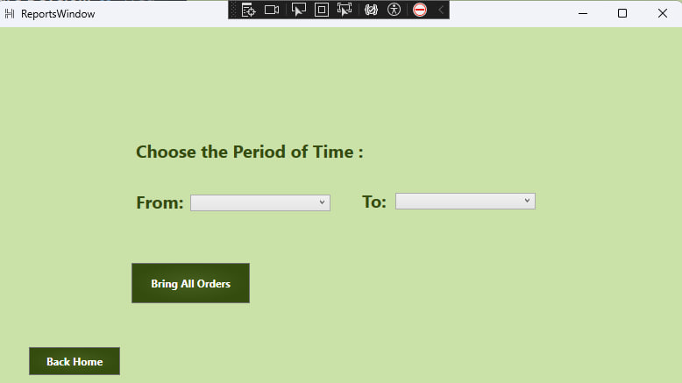
Report

Slide 13
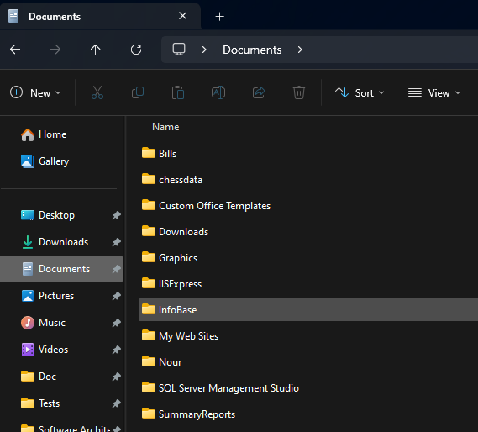
Create Text Files

Slide 14
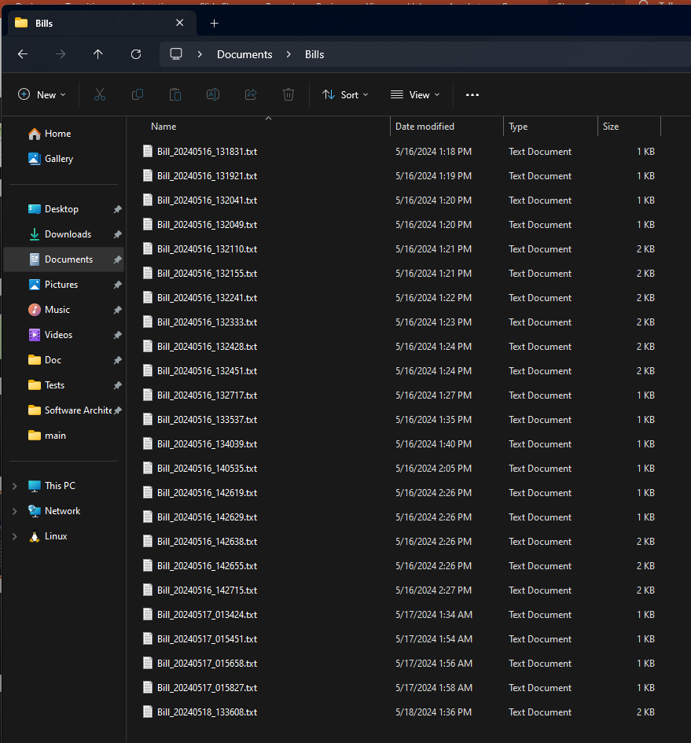
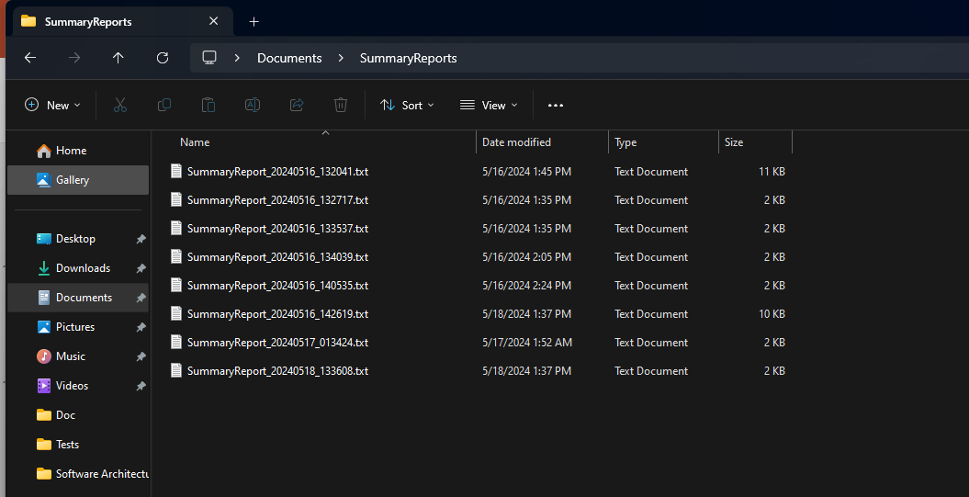
Summery Reports and Bills

Slide 15
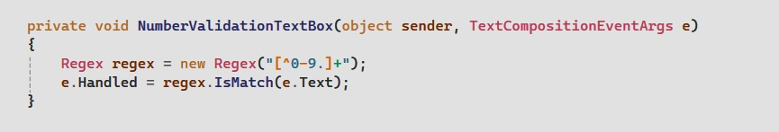
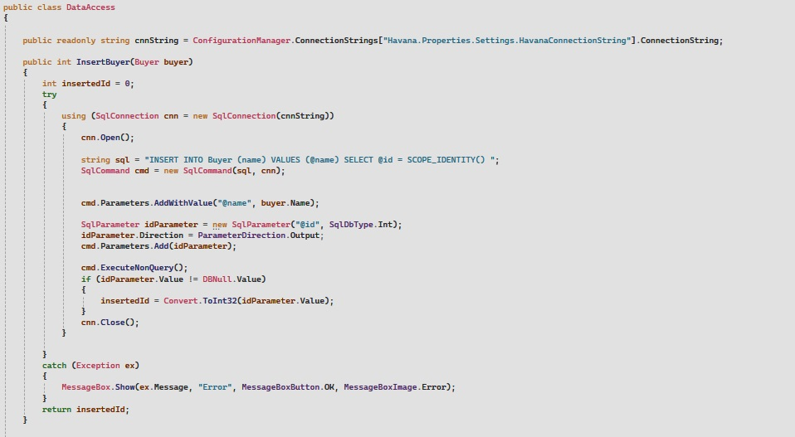
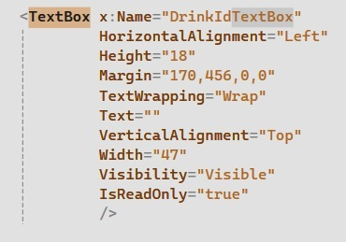
Validation

Slide 16
Thank you
Thanks for my Supervisor Mr. Kurochka Konstantin Sergeevich for all his help and support during Development of this Application.

